Slide 1
3PS (TO BE CHANGED)
Ronald Uy
CMSI 402 – Spring 2019

Slide 2
What is a third-person perspective?
Playable character is visible
Camera POV is behind the character
Wider field of view

Slide 3
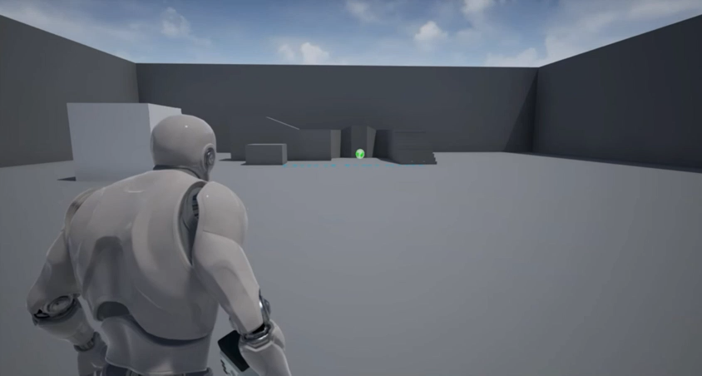
Project Description
Third-person shooter based off of games like Uncharted with the sci-fi themes of a Halo game
Will be made on Unreal Engine 4.
Implement puzzles, traversal, and shooting

Slide 4
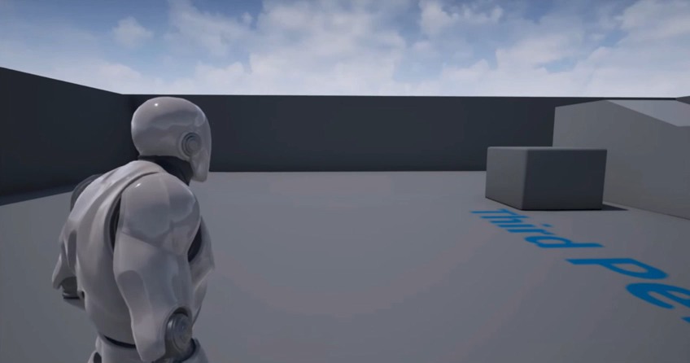
Project description
Control Scheme will satisfy both PC and console gamers.
Start off with a single player demo level (Point A to B)
Move towards 2 player mode (split screen, then online)

Slide 5
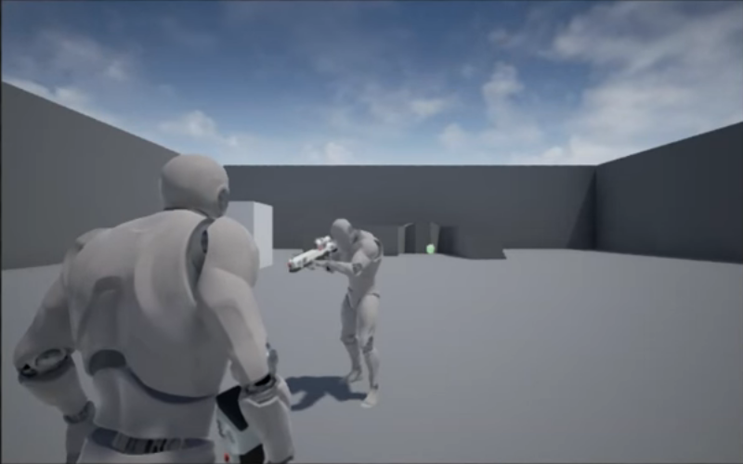
My interest/FUTURE plans
INTEREST
GAMES! What’s not to like?
Expressing my imagination by creating a game
Stories!
FUTURE PLANS (if there’s time)
Move towards 2 player mode (split screen, then online)
Customization!
Eventually work towards making a story-driven campaign.
Implement a Team Deathmatch & PVP mode.

Slide 6
questions

